Slide 1
CWC 2016 Tunnel Team B: Concept Generation
Michael Evans, Korey Holaas, Scott Muente, Jess Robinson, Zachary Sabol, and Brayden Worrell
Slide Number

Slide 2
PROJECT DESCRIPTION
Collegiate Wind Competition 2016 Tunnel Team B covers the electric side of the Wind Tunnel Turbine Design: Controls, Load, Power Electronics, and Software.
Earn points on the Tunnel Tests in various categories, such as Safety, Power Curve Performance, and others.
The Tunnel Design should be a model of the Deployment Team and the Business Team’s work.
Name - Slide Number

Slide 3
REQUIREMENTS
Customer Requirements
Power Curve Performance (50), Control of Rated Power (40), Control of Rotor Speed (40), Cut-in Wind Speed (25), Safety (25), Supply a Load System (25), Provide Appropriate Wiring/Connections (25), Redundant Braking System (20), Durability (15), and Small Scale (10).
Engineering Requirements
Produce Sufficient Continuous Power, Withstand High Wind Speeds, Design an Innovative Load, Fit in the Testing Space, Quickly Assemble and Disassemble, and Shut Down on Push Button Activation & Loss of Power.
Name - Slide Number

Slide 4
DESIGNS CONSIDERED - CONTROLS
Investigated 6 different brake systems:
AC Wye-Connected Brake
Connect +, -, and GND leads of generator
Latching relay used to toggle connections, other options possible [J1]
DC Dynamic Brake
Connect + and - leads of DC converter, via latching relay
Disk Brake - Hydraulically Controlled
Disk Brake - Pneumatically Controlled
Hysteresis Brake [J2]
Same principles used to reduce speed as motor uses to produce speed
Webbed Frog Feet Air Brake [J3]
Attach to blades, used Asknature.com for inspiration
Jess Robinson - Slide Number

Slide 5
DESIGNS CONSIDERED - LOAD
Diversion Load - A battery bank and a resistive load that switch when the battery is fully charged
Smart Material Load - Flexible materials that change in shape based changes in their electric field
Butterfly Smart Materials (nature inspired) - A smart material load that is shaped like a butterfly and flaps its wing when it is being charged
Heat Sink Load - A fully resistive load that heats up and a heat sink fan to keep it from over heating
Electric Eel Discharge (nature inspired) - A load that discharges all of its power when the turbine brakes
Display Monitor - A monitor that is hooked up to a battery bank load displays relevant data about the turbine’s status
Name - Slide Number

Slide 6
DESIGNS CONSIDERED - POWER ELECTRONICS
Rectification
Passive Rectification with Shottky Diodes - Large voltage drop across Rectifier, works without input.
Active Rectification with MOSFETs/Relays - Lower voltage drop leads to increased efficiency, more difficult to control.
Active Rectification with MOS-controlled Thyristors - Higher voltage drop, less complex to operate, and needs to be activated less often.
DC/DC Conversion
Buck-Boost Converter - Inverting non-isolated single inductor step-up or step-down DC-DC converter.
Flyback Converter - Inverting transformer isolated version of the Buck-Boost Converter.
SEPIC Converter - Non-inverting transformer isolated step-up or step-down DC-DC converter.
Name - Slide Number

Slide 7
DESIGNS CONSIDERED - SOFTWARE
Use Loss of Power Algorithms to Respond to Push Break - If power is disconnected, do the same thing as if the button was pressed, and vice versa.
Infrared Detector to Measure Instantaneous RPM and TSR - Use an emitter and sensor to measure the reflected IR beam, and obtain tip-speed ratio.
PID and PWM to Direct Controls - Proportional Integral Derivative and Pulse-Width Modulation coding helps controls be more efficient.
Sensors built into Power Electronics - Using sensing circuits (voltage and current) to calculate RPM, Power, and TSR.
Arduino Sleep Library - Use the Sleep function to lower power losses (20 * 10^-6 Amps) [B1].
Name - Slide Number

Slide 8
DESIGNS SELECTED - CONTROLS
Brake Systems
Criteria | Weight | DC Brake | AC Brake | Hysteresis Brake
Power Consumption | 35% | 7 | 9 | 5
Complexity | 25% | 9 | 7 | 6
Size | 10% | 9 | 8 | 4
Braking Power | 20% | 6 | 7 | 9
Cost | 10% | 9 | 9 | 6
Total | 100% | 7.7 | 8 | 6.05
Jess Robinson - Slide Number

Slide 9
DESIGNS SELECTED - LOAD
Criteria | Weight | Diversion load | Heat Sink | Eel Discharge
Cost | 30% | 8 | 8 | 6
Simplicity | 30% | 8 | 9 | 5
Creativity | 20% | 7 | 4 | 9
Functionality | 20% | 8 | 5 | 7
Total | 100% | 7.8 | 6.9 | 6.5
Name - Slide Number

Slide 10
DESIGNS SELECTED - POWER ELECTRONICS
DC/DC Conversion
Rectification
Criteria | Weight | Buck-Boost | Flyback | SEPIC
Power Losses | 15% | 4 | 8 | 8
Size | 25% | 8 | 6 | 4
Cost | 10% | 8 | 7 | 6
Complexity | 20% | 8 | 7 | 5
Output Range | 30% | 8 | 4 | 2
Total | 100% | 7.4 | 6.0 | 3.9
Criteria | Weight | Passive | MOSFET | MCT
Voltage Drop | 40% | 3 | 8 | 5
Power Draw | 30% | 4 | 7 | 4
Complex | 20% | 8 | 4 | 2
Cost | 10% | 6 | 5 | 3
Total | 100% | 5.4 | 6.6 | 3.9
Name - Slide Number

Slide 11
DESIGNS SELECTED - SOFTWARE
Criteria | Weight | LoP and Button | PID and PWM | Sleep Library
Power Draw | 35% | 6 | 5 | 7
Braking | 25% | 7 | 8 | 5
Responsive | 25% | 6 | 8 | 6
Difficulty | 15% | 6 | 5 | 8
Total | 100% | 6.25 | 6.50 | 6.40
Name - Slide Number

Slide 12
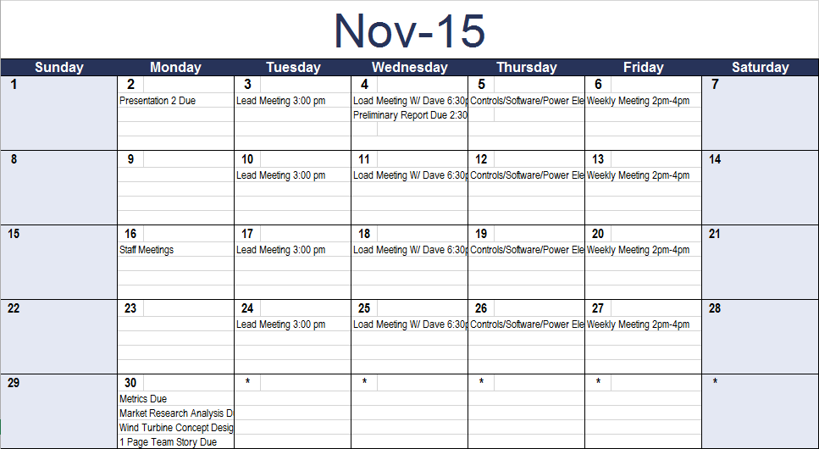
SCHEDULE - NOVEMBER
Name - Slide Number

Slide 13
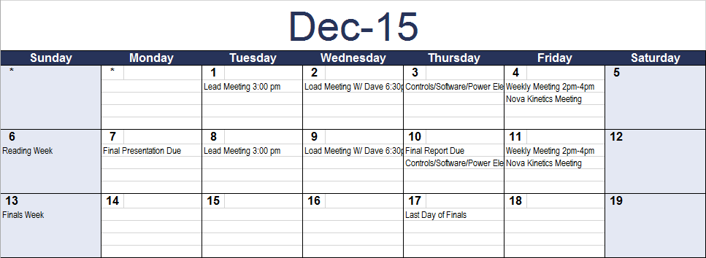
SCHEDULE - DECEMBER
Name - Slide Number

Slide 14
BUDGET
Brake Systems:
Primary brake system: TE RT314A06 latching relay, unit price: $2.47
Redundant brake system: ST P75NF75 MOSFET (transistor), unit price: < $1
Bulk reel of 22 AWG wire: $6:49
Liquid electrical tape: $7
Manual override button: $8
JST RCY plug: $0.50
Name - Slide Number

Slide 15
CONCLUSION
Controls Idea: Connecting +, -, GND of AC output together to brake the turbine
Load Idea: Diversion Load that is part battery bank and part resistive load
Power Electronics Ideas: Active Rectification with MOSFETs and Flyback Converter
Software Idea: PID and PWM to Direct Controls
Name - Slide Number

Slide 16
REFERENCES
[1] - Arduino Playground - ArduinoSleepCode [online] Available: http://playground.arduino.cc
[2]'THEORYOF DIELECTRIC ELASTOMERS', Acta Mechanica Solida Sinica, vol. 23, no. 6, pp. 1-2, 2010.
[3]'Finite Element Modeling of the Sensing and Energy Harvesting Performance in Ionic Polymer Metal Composites', Electroactive Polymer Actuators and Devices, vol. 8687, pp. 1-5, 2013.
[J1] TE Connectivity Relay Products, “Power PCB relay RT1 bistable,” RT314A06 datasheet, Oct. 2014.
[J2] Magtrol, Hysteresis brakes and clutches [Online Datasheet]. Available: http://www.electro-meters.com/Assets/PDF_files/Magtrol/Dynamometers/hysteresis.pdf
[J3] (2008). Feet used to slow landings: True frogs [Online]. Available: http://www.asknature.org/strategy/2a1f9703445f72a43e51800965fd03fa
Slide Number

Slide 17
QUESTIONS?
Slide Number

